Slide 1
Lecture # 03 uninformed searches
Artificial Intelligence

Slide 2
outcomes
After completing this lab, students will be able to understand:
Breadth-First Search (BFS):
The concept of exploring a search space in a breadth-first manner.
How BFS uses a queue data structure to keep track of the nodes to be explored.
How BFS guarantees finding the shortest path in terms of the number of edges.
Depth-First Search (DFS):
The concept of exploring a search space in a depth-first manner.
How DFS uses a stack or recursion to keep track of the nodes to be explored.
How DFS may not guarantee finding the shortest path but can be more memory efficient compared to BFS.
Uniform Cost Search (UCS):
The concept of exploring a search space based on the cost of each path.
How UCS uses a priority queue to prioritize nodes with lower path costs.
How UCS can find the optimal solution in terms of total cost.
The differences and trade-offs between BFS, DFS, and UCS:
Time complexity and space complexity considerations.
Completeness and optimality properties of each algorithm.
The impact of different problem characteristics on the performance of each algorithm.

Slide 3
Introduction to uninformed searches
In artificial intelligence and computer science, search algorithms are used to find solutions to problems by intelligently traversing through a large problem space. Search algorithms can be categorized as either informed or uninformed.
Today we will focus on uninformed search algorithms, also known as blind searches. Uninformed search algorithms traverse the problem space without any knowledge about which actions lead to the goal state. They have no information about the structure of the problem to determine the best order of expanding nodes.

Slide 4
algorithms
The key uninformed search algorithms we will discuss include:
Breadth-first search (BFS)
Depth-first search (DFS)
Uniform-cost search (UCS)

Slide 5
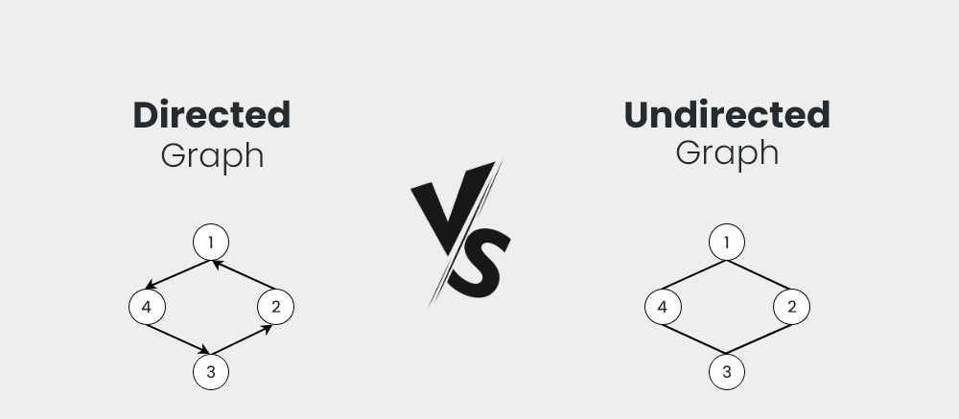
Directed VS undirected graph

Slide 6
Bfs: breadth first search
Breadth-first search expands the shallowest nodes in the tree first, exploring all nodes on the current depth before moving on to nodes at the next depth level. It is a complete algorithm that is guaranteed to find the shortest solution if one exists.

Slide 7

Advantage:
The major advantage of BFS is its completeness
but it uses a large amount of memory to keep track of explored and unexplored nodes. For problems with a large branching factor, the memory requirements become impractical.
Dis-Advantage:

Slide 8
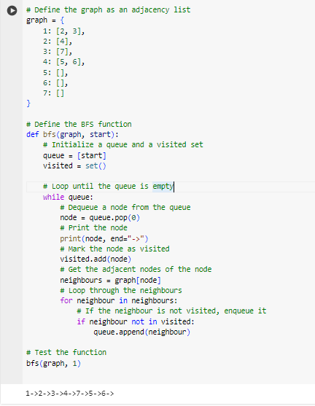
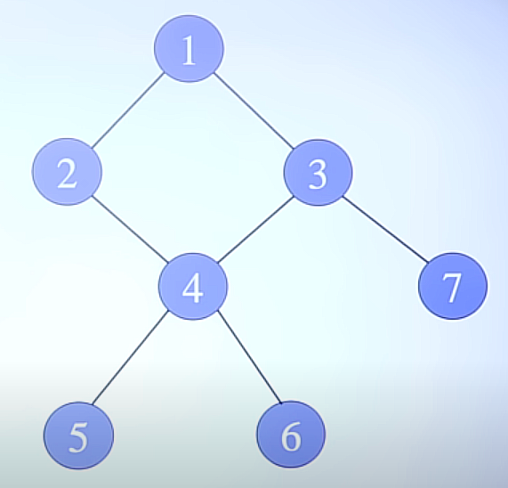
Example: bfs

Slide 9
Depth first search
In depth-first search, we expand nodes by going as deep as possible along each branch before backtracking and exploring alternate paths

Slide 10
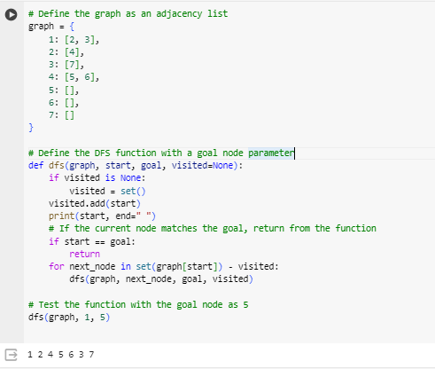
Example:

Slide 11
Advantage of dfs:
. It uses less memory than BFS as it only needs to keep track of the current path.

Slide 12
Drawback of dfs:
However, DFS is not complete and may miss solutions or run into infinite loops on cyclic graphs. It is also not optimal as it does not necessarily find the shortest solution first.

Slide 13
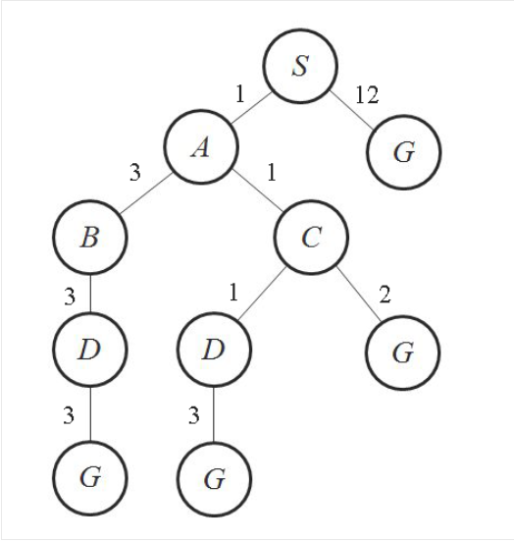
Uniform cost search:
Uniform-cost search (UCS) orders the frontier using the path cost, always expanding the lowest cost node first. It guarantees an optimal solution if the cost function accurately captures the true cost.

Slide 14
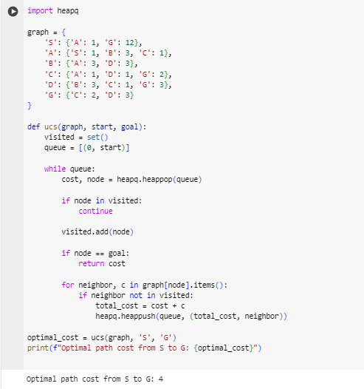

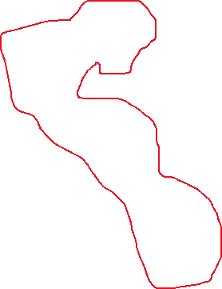

Example:

Slide 15
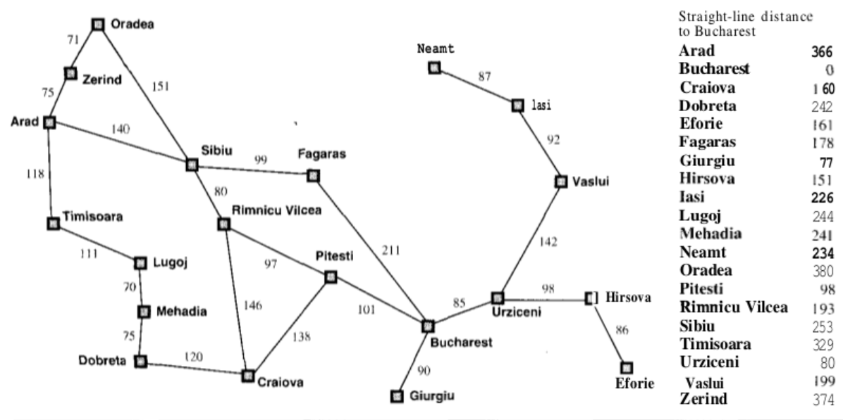
Arad to bucharest

Slide 16
ADVANTAGES OF UCS:
Optimality: UCS is an optimal algorithm, meaning it is guaranteed to return the lowest cost solution if one exists. It will always expand the lowest cost node first.
Simplicity: The algorithm is very simple - it just orders nodes in the queue based on path cost and expands the lowest cost node next. This makes it easy to implement.

Slide 17
disAdvantage of ucs:
Memory requirements: Like breadth-first search, UCS stores all nodes in memory until the final solution is found. This becomes prohibitive for large graphs with a huge branching factor.
Time complexity: For the same reason, the time complexity of UCS is exponential in the worst case as it has to explore the entire graph breadth-wise to prove optimality.

Slide 18
Conclusion:
In this lecture, we discussed the three fundamental uninformed search algorithms - BFS, DFS, and UCS. When the problem structure and heuristics are unknown, these blind search techniques provide systematic ways to explore the problem space and find optimal solutions, given their computational constraints.

Slide 19
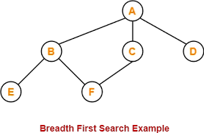
Task 1:
Implement BFS & DFS Algorithm in python on the given graph:

Slide 20
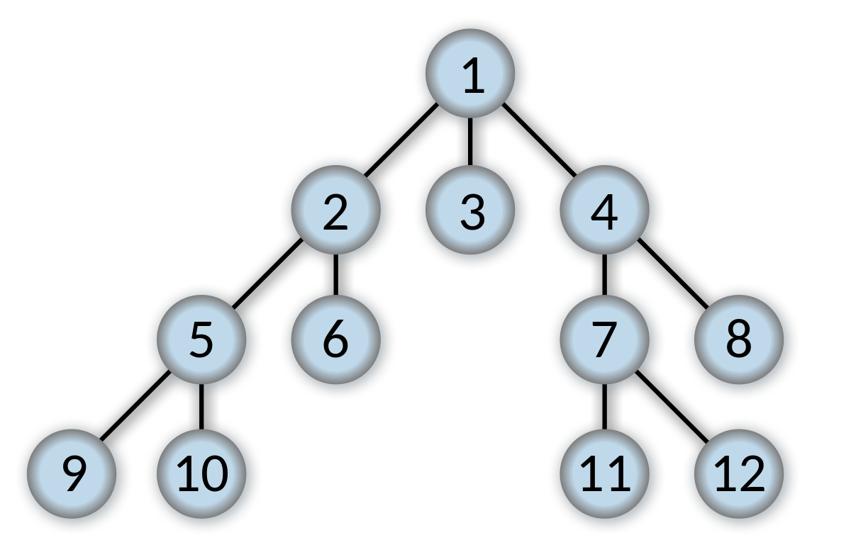
Task 2:
Implement the BFS and DFS Algorithm using recursion on the given graph with starting node = 1 and goal =6

Slide 21
Task 3:
Apply the UCS algorithm on a map given below. Find optimal cost from ARAD to BUCHAREST

Slide 22
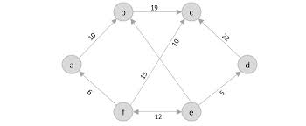
Task 4:
Implement the Travelling Salesmen problem using uninformed searches on given Directed graph

